Slide 1
WELCOME TO
TEDDY STORE

Slide 2
Introduction -
I have developed a project using Html, CSS and JavaScript
technologies and named it as Online Teddy Store.
We can choose Teddy’s among wide variety of collection in the store .
We can add the Teddy’s to the cart and placed the order.

Slide 3
Definition-
HTML:-
HTML stands for Hyper Text Markup Language
HTML is the standard markup language for creating Web pages
HTML describes the structure of a Web page
HTML consists of a series of elements
HTML elements tell the browser how to display the content
CSS:-
CSS stands for Cascading Style Sheets
CSS describes how HTML elements are to be displayed on screen, paper, or in other media
CSS saves a lot of work. It can control the layout of multiple web pages all at once
External style sheets are stored in CSS files

Slide 4
JAVASCRIPT-
JavaScript is a Scripting language that enables you to create dynamically updating content , control, multimedia , animate images etc..,
JavaScript can calculate, manipulate and validate data.
JavaScript renders web pages in an interactive and dynamic fashion.
This allowing the pages to react to events , exhibit special effects, accept variable text, validate data, create cookies , detect a user’s browser , etc.,
JQuery-
Jquery is a library , derived from JavaScript .It is a open source JavaScript library that simplifies the interactions between HTML/CSS document.
It is widely famous with its philosophy of “write less , Do more”
Jquery is more user-friendly only a few lines of code have to write in order to have its functionality.

Slide 5
Tags-
<link> :-It defines the relationship between the current document and an external resource. It is most often used to link to external style sheets.
<meta>:-It always go inside the <head> element, and are typically used to specify character set, page description, keywords, author of the document, and viewport settings. Metadata will not be displayed on the page, but is machine parsable.
<script>:-It is used to embed a client-side script (JavaScript). The <script> element either contains scripting statements, or it points to an external script file through the src attribute.
<section>:-It defines a section in a document.
<nav> :-It defines a set of navigation links. The <nav> element is intended only for major block of navigation.
<button>:-It defines a clickable button. Inside a <button> element you can put text (and tags like <i>, <b>, <strong>, <br>, <img>, etc.). That is not possible with a button created with the <input> element!

Slide 6
<style>:-Iti s used to define style information (CSS) for a document. Inside the <style> element you specify how HTML elements should render in a browser.
<div>:-It defines a division or a section in an HTML document.It is used as a container for HTML elements - which is then styled with CSS or manipulated with JavaScript.It is easily styled by using the class or id attribute.
<span>:-It is an inline container used to mark up a part of a text, or a part of a document.
<img>:-It is used to embed an image in an HTML page.It creates a holding space for the referenced image.
<input>:-It specifies an input field where the user can enter data.
<form>:-It is used to create an HTML form for user input.It can contain one or more of the following form elements:<input>, <textarea> ,<button>,<select>
<fieldset>:-It is used to group related elements in a form.It draws a box around the related elements.

Slide 7
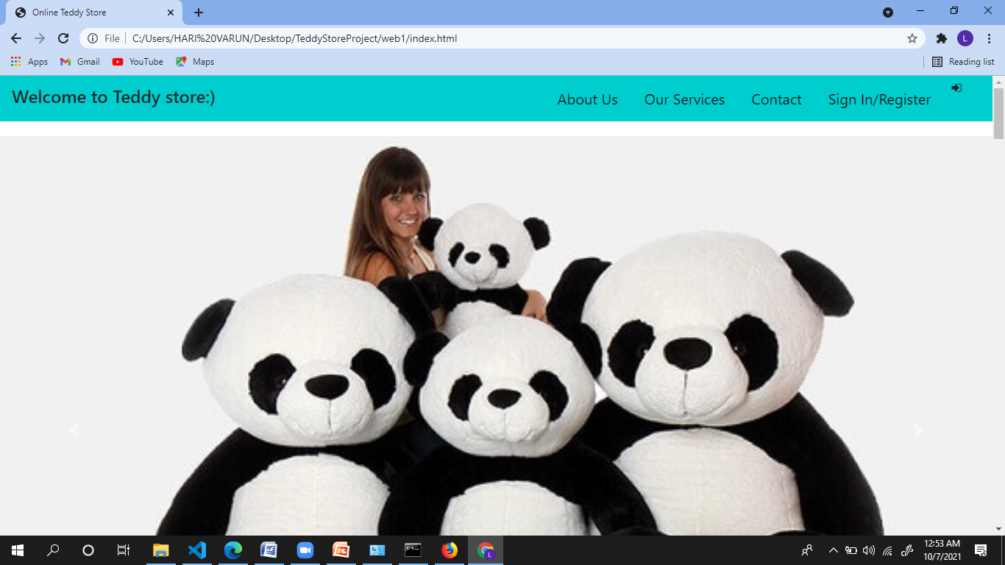
Sample output-

Slide 8
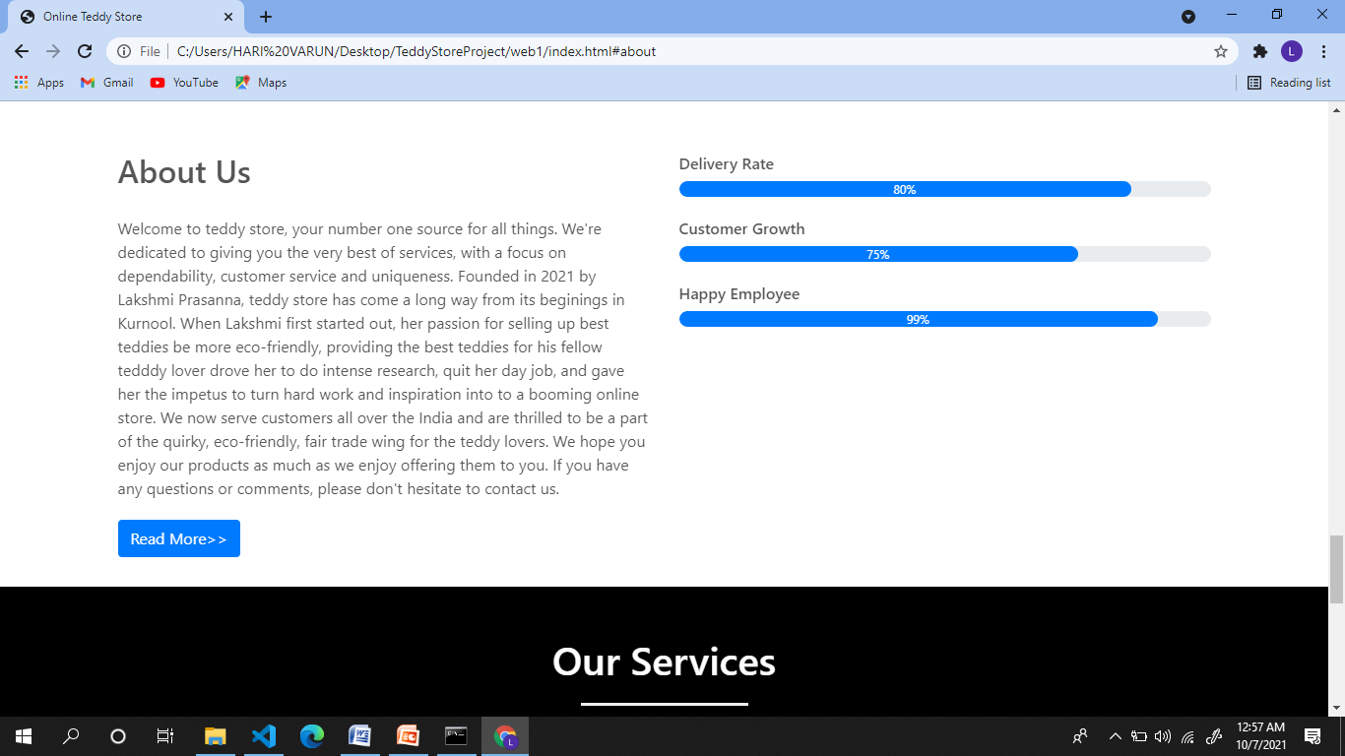

Slide 9
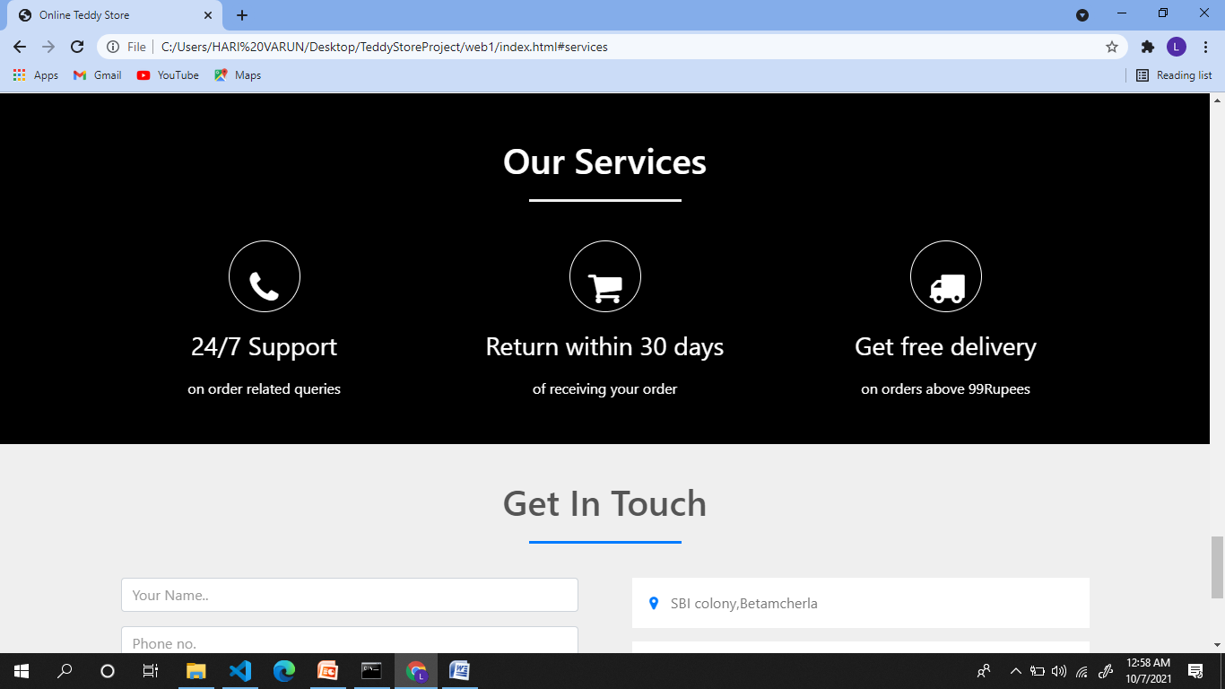
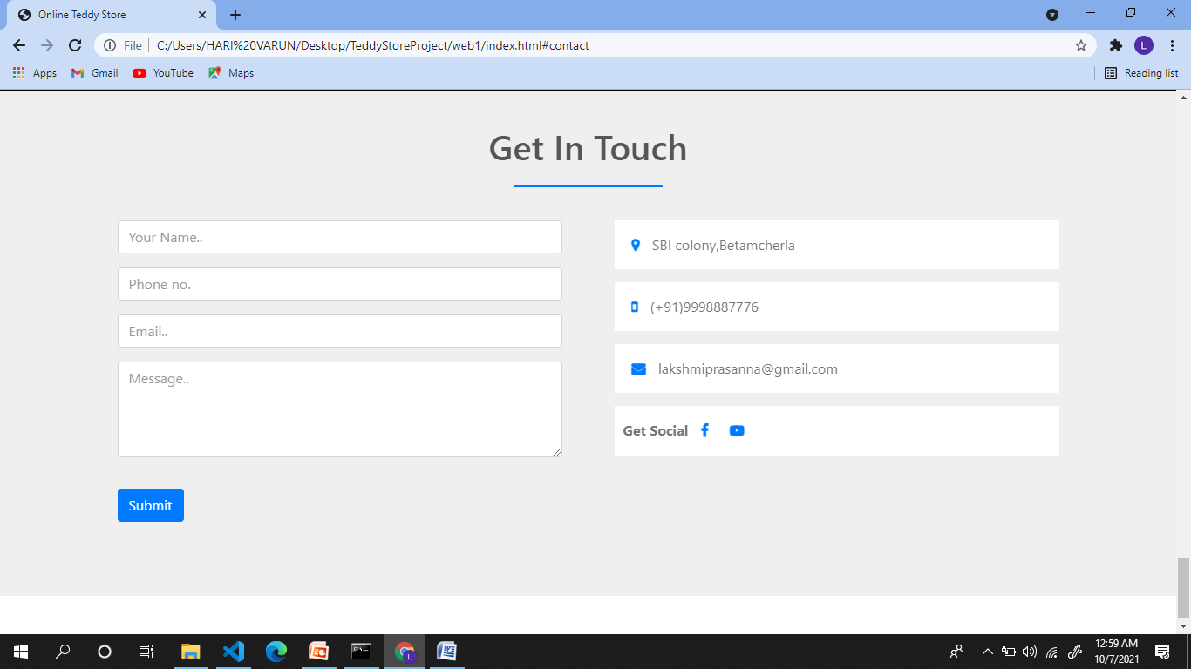

Slide 10
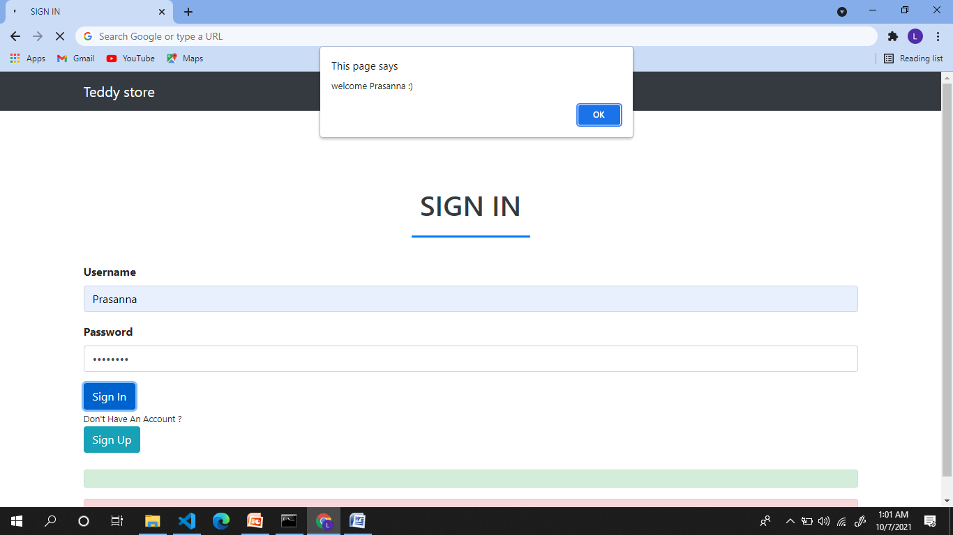

Slide 11
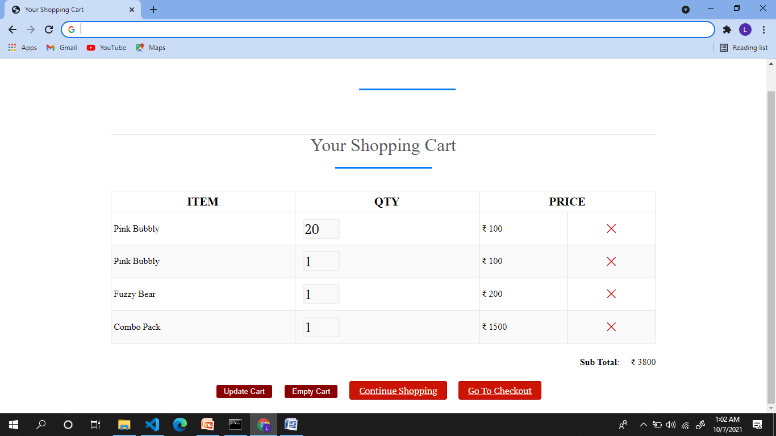
cart

Slide 12
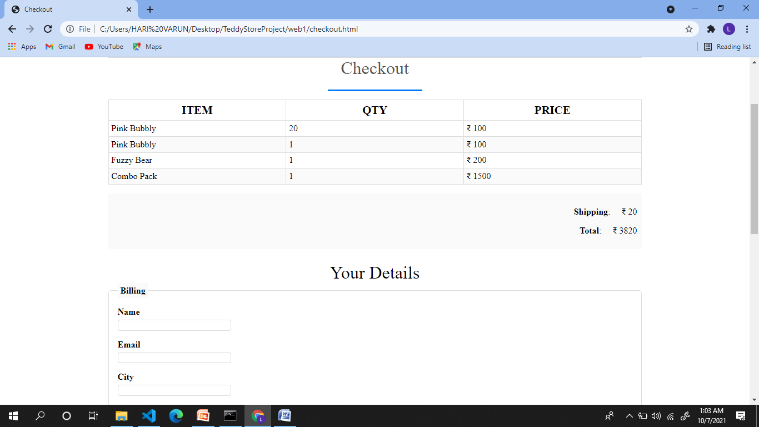

Slide 13
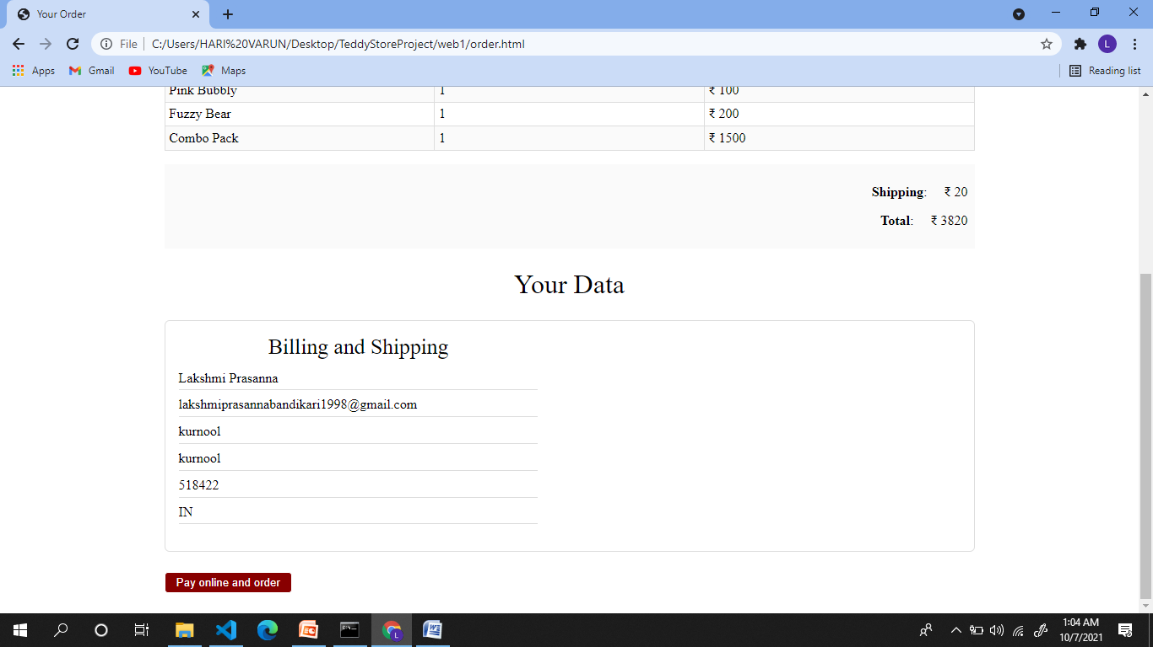
Order summary

Slide 14
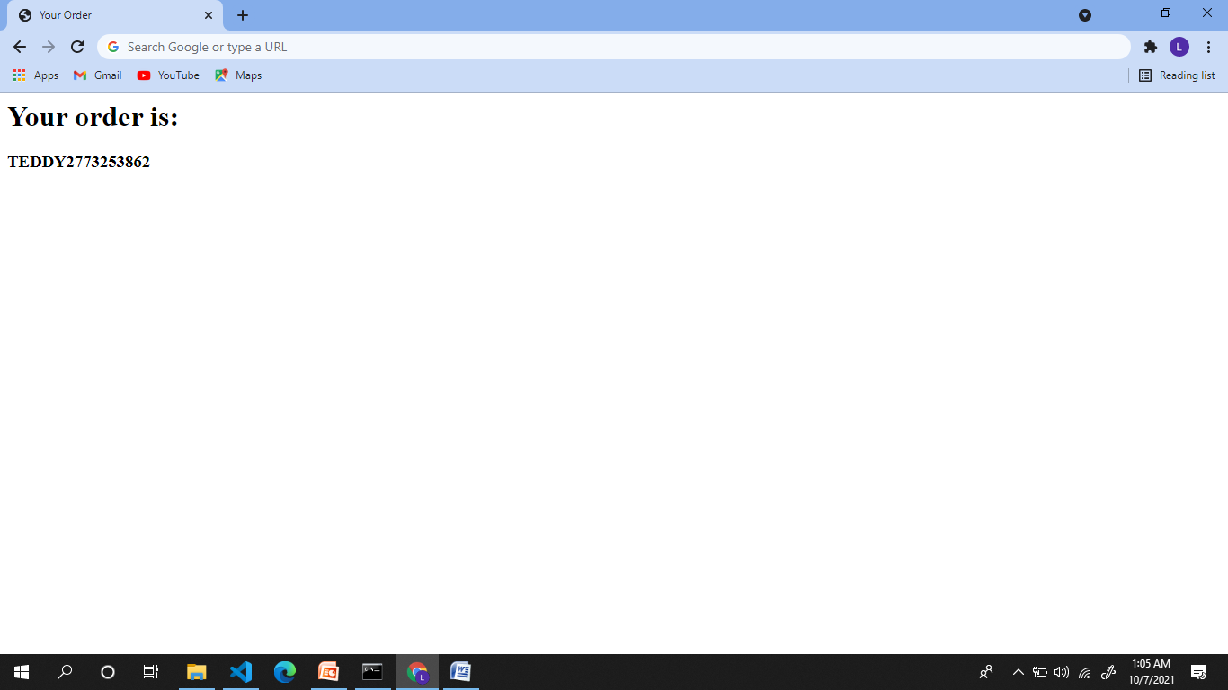
Order confirmation

Slide 15


